Slide 1
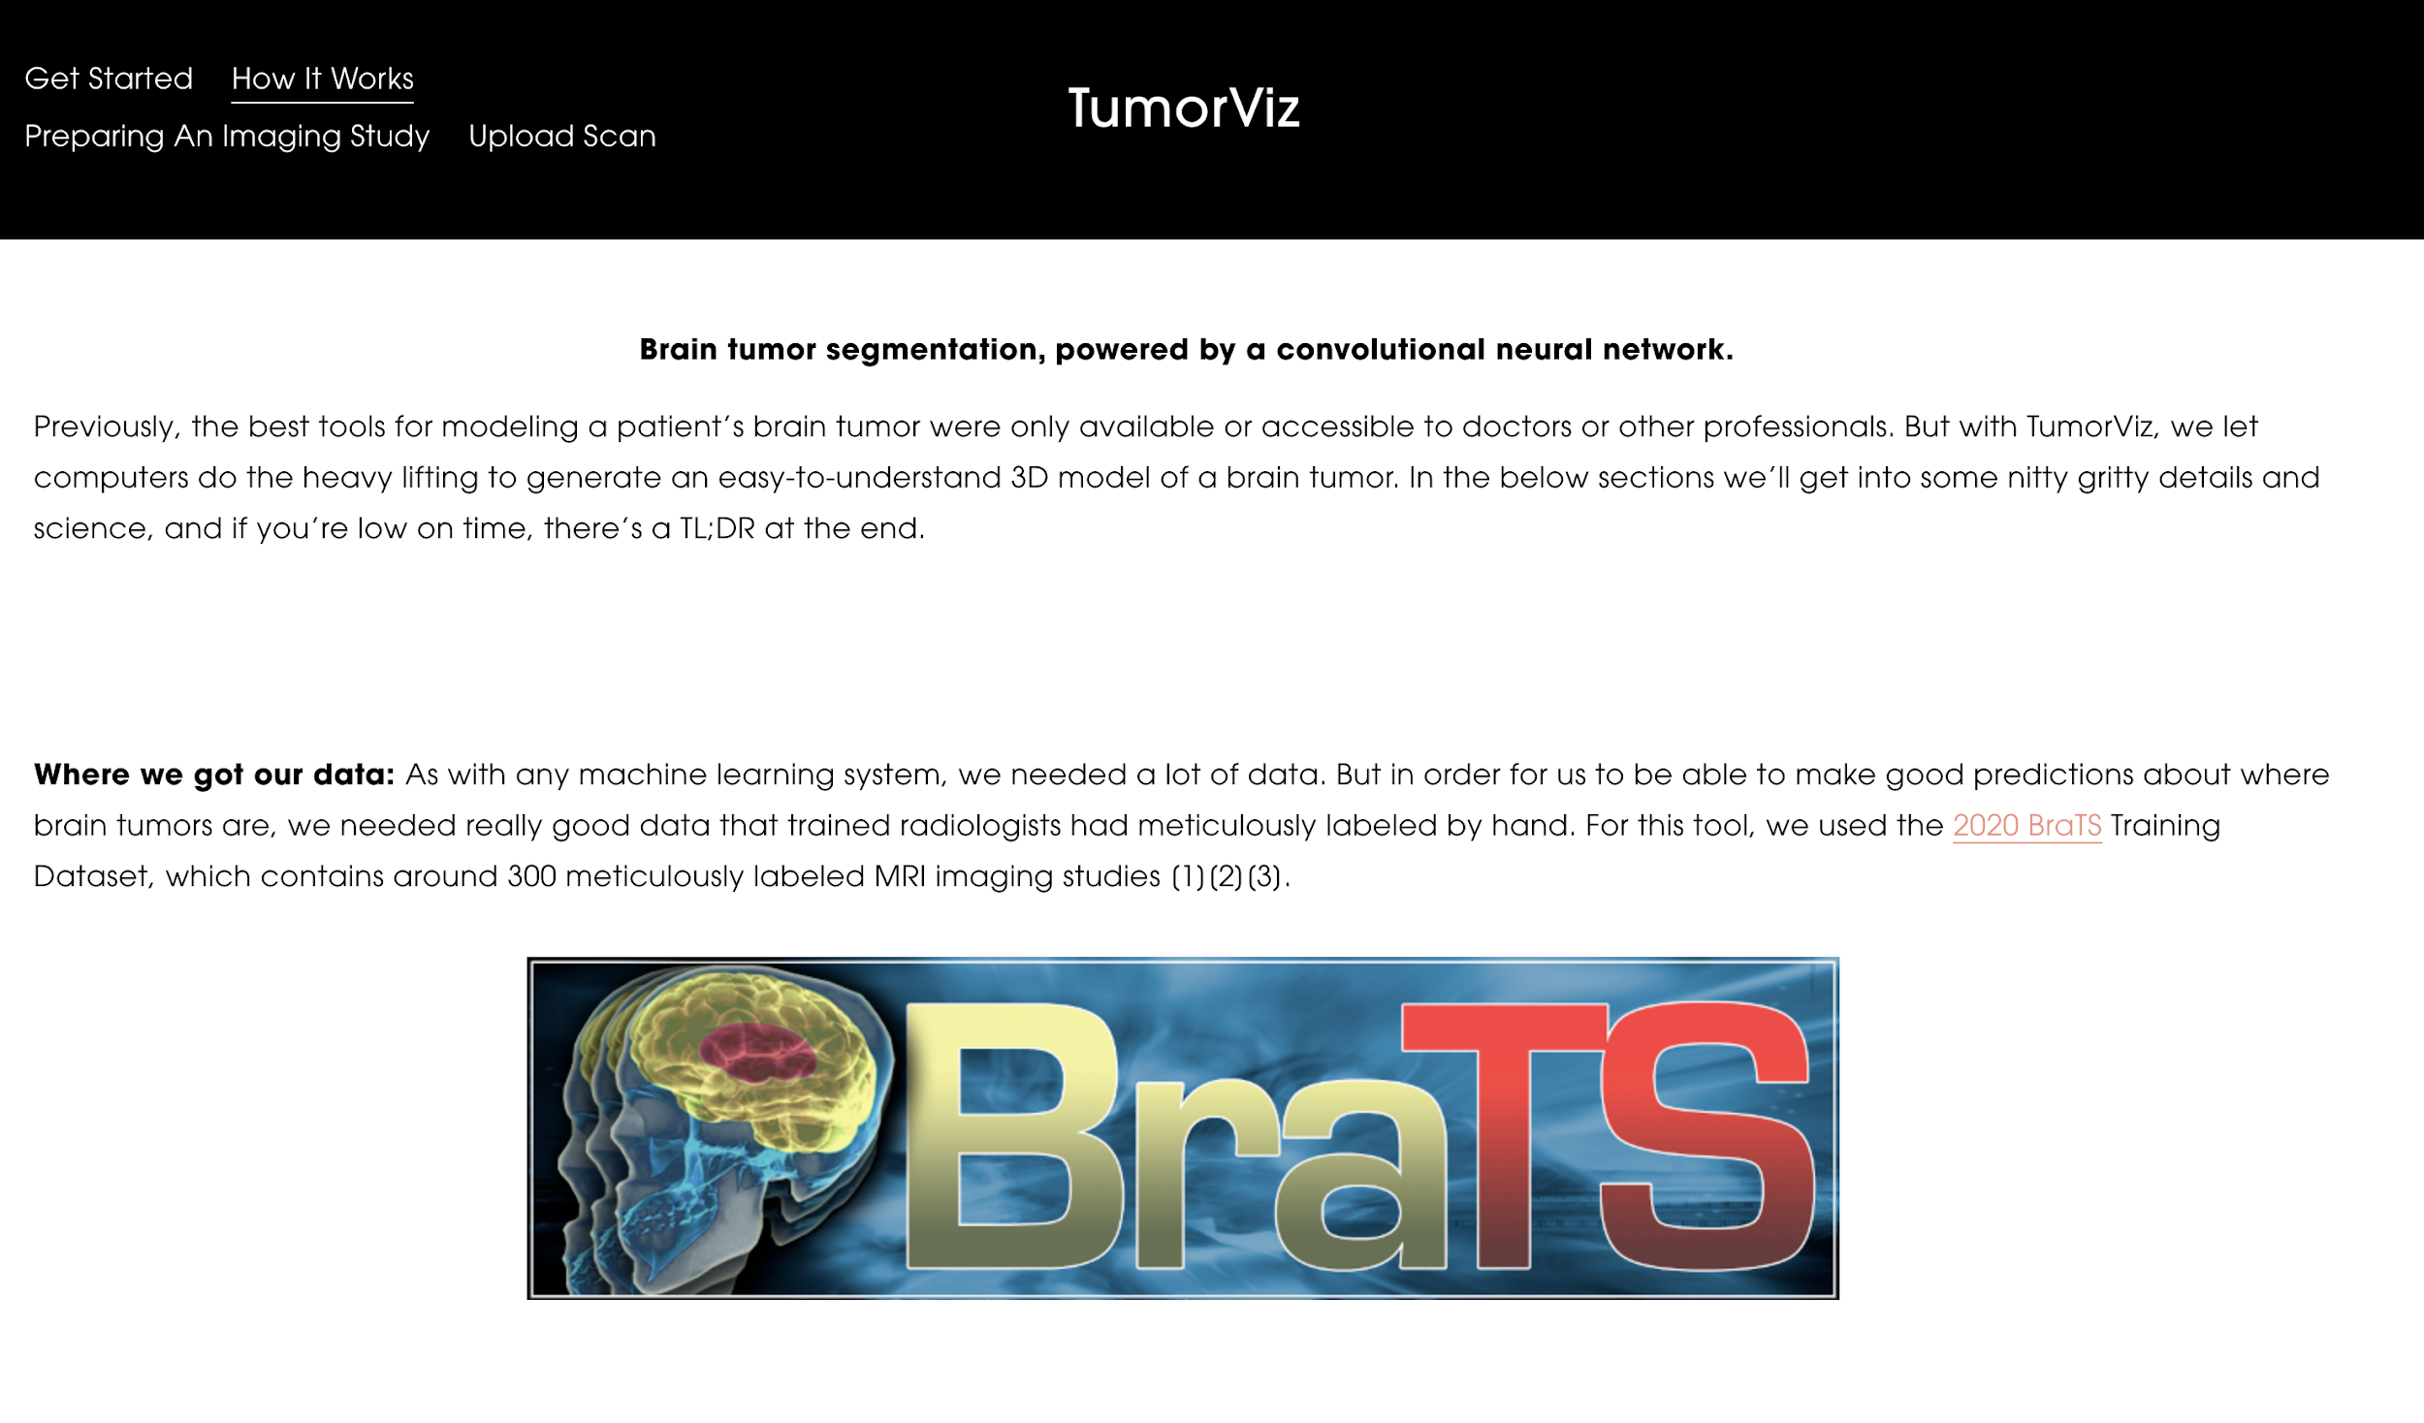
TumorViz
Isaac Smith
11/20/2020

Slide 2
Project Inspiration
My own experience with brain injuries
Lack of medical literacy when it comes to interpreting medical imaging
Increasing patient agency when it comes to understanding and approaching treatment of brain tumors
Give patients access to tools that can help them explain their condition to loved ones

Slide 3
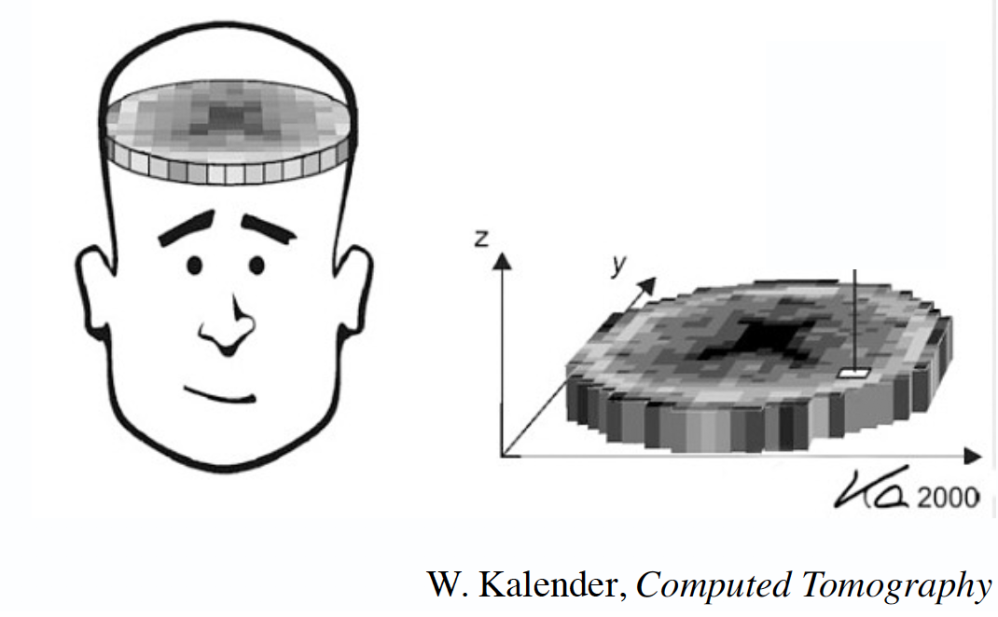

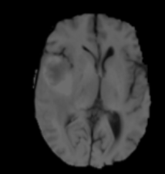
What do the scans look like?
T1
T2
1 Study
T1 w/c
155 Images
256x256 Image
Flair
4 Modalities

Slide 4
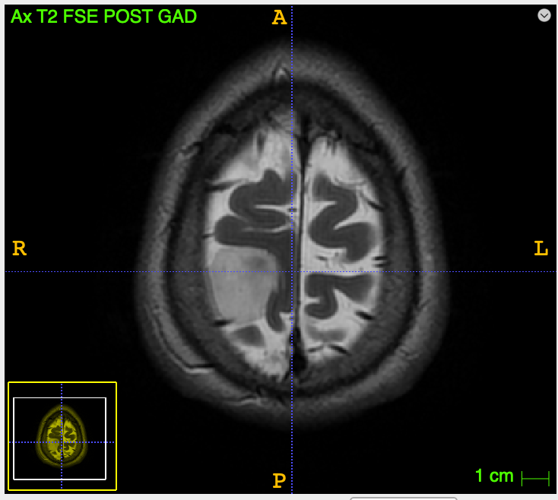
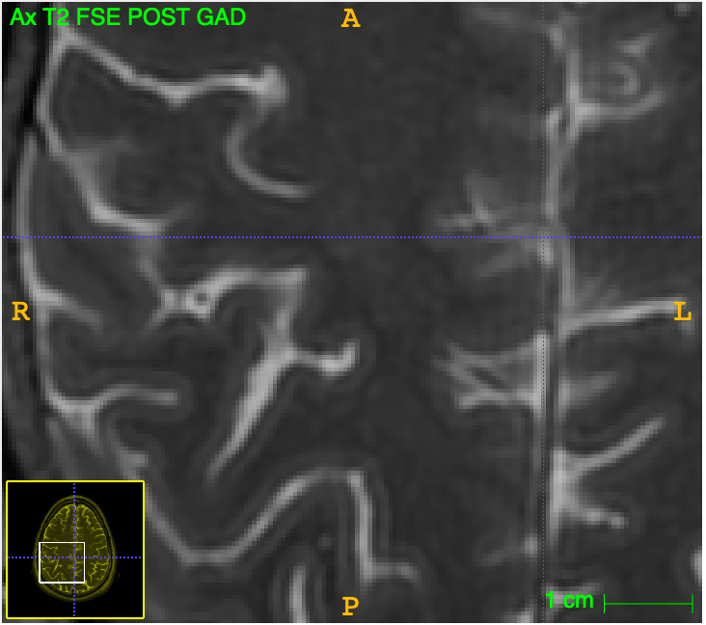
Goal:
Tumor segmentation!
Allow for a patient to upload their raw scans, and have our model segment the tumorous regions and generate a 3D model

Slide 5
Dataset
2020 BraTS Dataset(1)(2)(3)
~300 Training Studies (both high-grade and low-grade gliomas), ~75 Testing Studies
Each training study had an associated stack of labeled ground-truths
A mask that had individual labels for edema, advancing tumor, non-advancing tumor, or the necrotic tumor core
[1] B. H. Menze, A. Jakab, S. Bauer, J. Kalpathy-Cramer, K. Farahani, J. Kirby, et al. "The Multimodal Brain Tumor Image Segmentation Benchmark (BRATS)", IEEE Transactions on Medical Imaging 34(10), 1993-2024 (2015) DOI: 10.1109/TMI.2014.2377694
[2] S. Bakas, H. Akbari, A. Sotiras, M. Bilello, M. Rozycki, J.S. Kirby, et al., "Advancing The Cancer Genome Atlas glioma MRI collections with expert segmentation labels and radiomic features", Nature Scientific Data, 4:170117 (2017) DOI: 10.1038/sdata.2017.117
[3] S. Bakas, M. Reyes, A. Jakab, S. Bauer, M. Rempfler, A. Crimi, et al., "Identifying the Best Machine Learning Algorithms for Brain Tumor Segmentation, Progression Assessment, and Overall Survival Prediction in the BRATS Challenge", arXiv preprint arXiv:1811.02629 (2018)

Slide 6
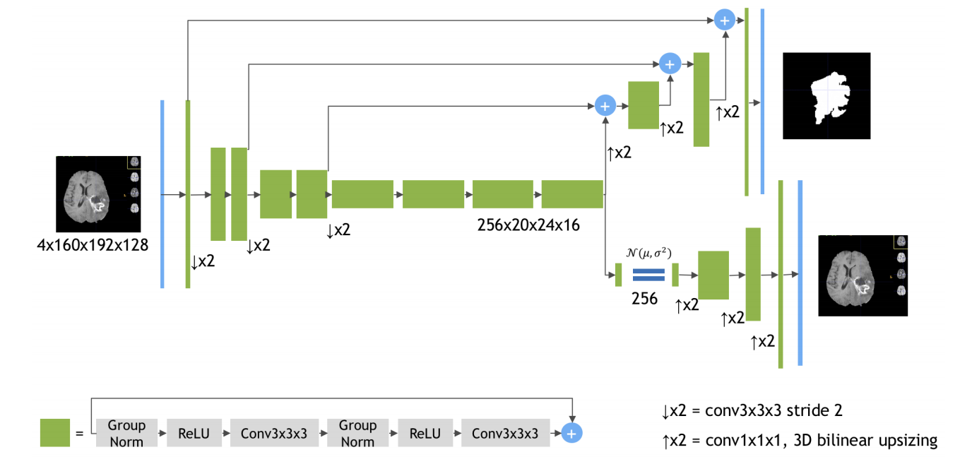
Final Model Design
Variational AutoEncoder (Neural Network)
Originally proposed and validated by researchers at NVIDIA(4)
Asymmetric encoder-decoder with 3D convolutional layers
Modified based on computational constraints to input significantly downsized images (4x64x64x64 instead of 4x160x192x128)
(4)
(4) Myronenko, Andriy. "3D MRI brain tumor segmentation using autoencoder regularization." International MICCAI Brainlesion Workshop. Springer, Cham, 2018.

Slide 7
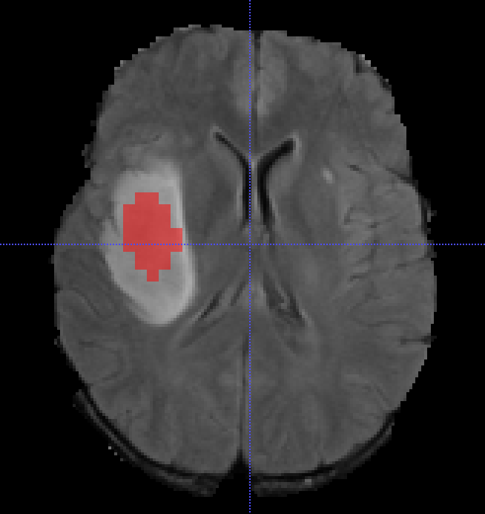
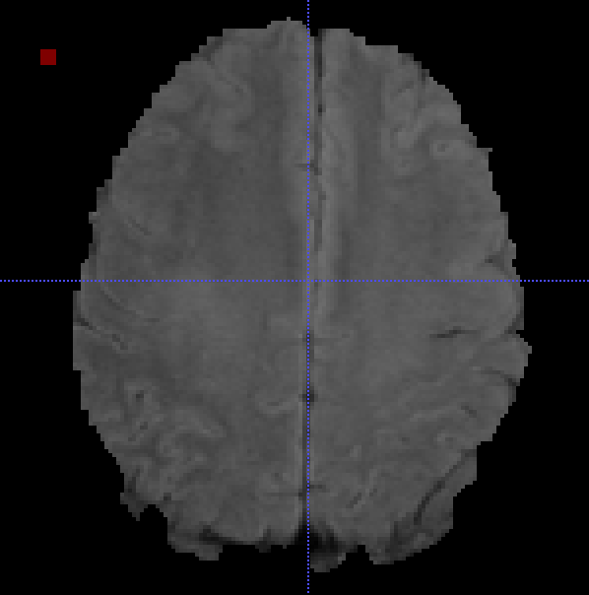
Model Performance
Training performance:
Dice score of over 80% (original model from NVIDIA had close to 90%)
Very promising!
But…
Actual test performance is hit or miss
Significant computational limitations:
Could only train on 10 downscaled studies without running out of memory, and could not load full-res scans with the most textural details
Leads to reduced generalizability, output resolution, and overfitting

Slide 8
Website
Built tumorviz.com to house everything needed in this project:
Information about how the project works
Step-by-step guide about preparing files for upload
Upload form to submit scans
Sample interactive model

Slide 9
Demo!
www.TumorViz.com

